Slide 1
From ideas to laws
they
come
do
Where
?
from

Slide 2
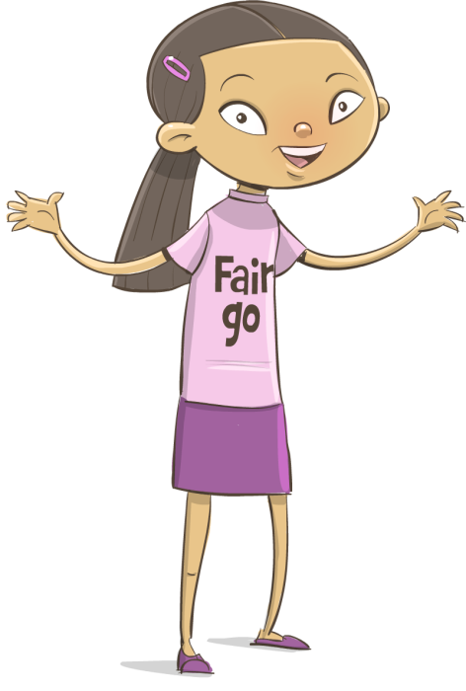
Ideas for creating or changing laws
The media broadcasts debates about bills passing through parliament. But where do the ideas for these bills come from?

Slide 3
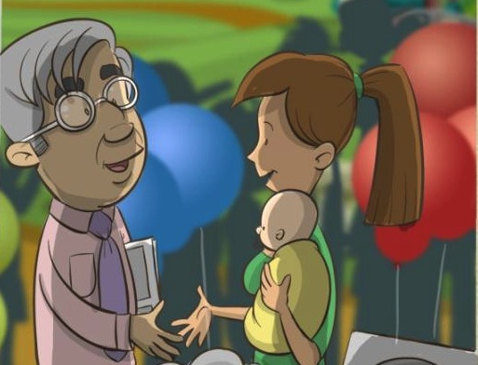
Community issues and concerns
Elected members of parliament use different ways to communicate with their community and respond to community issues and concerns as they arise.

Slide 4
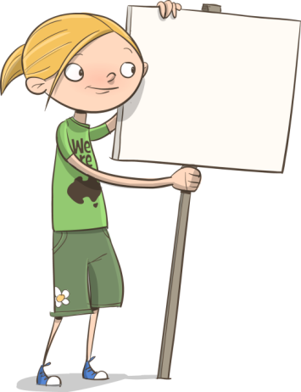



Ideas for new laws
The origin of ideas for a new law can be varied, for example:
election promises
a particular position on an issue by a new government
changes to administrative laws as a result of changes in technology.
responses to community concerns

Slide 5
Ideas for new laws
The role of a law is to protect the rights of citizens and uphold Australian values and behaviours.
Individuals and/or groups in the community raise a concern about an issue.
A member of parliament might introduce a bill into parliament for discussion and debate. If the bill is agreed to, it is passed and becomes Australian law.
All Australians have the responsibility to follow the law.

Slide 6
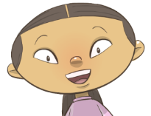
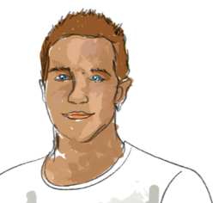
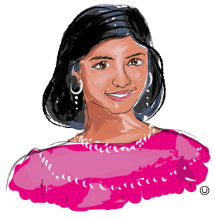
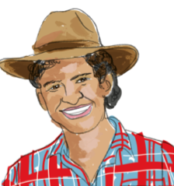
An example of a community concern
Community groups expressed a concern to the Queensland Government about road rules.
What might be a reason for each person’s point of view?
Bicycle safety is a concern for me. Too many cyclists have suffered injuries on our roads.
Some of the current road rules are confusing, one for the motorist and another for the cyclist.
People are encouraged to cycle more but some of the rules make it inconvenient. I always travel by car or bus.

Slide 7
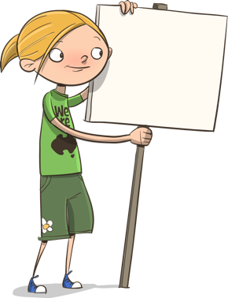

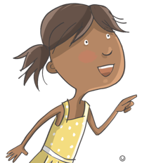



The influence of the community
Community groups can influence the government to change laws in a number of different ways.
A number of community groups and non-profit organisations, such as Bicycle Queensland, lobbied the government for better cycling conditions and laws to protect cyclists.
Reference: Bicycle Queensland, http://www.bq.org.au/about/what-is-bicycle-queensland/
Write or sign a petition
Write a letter to the editor of a newspaper
Be an informed voter
Join or start a group
Contact their representative by email
Contact the media

Slide 8

Responding to the community’s concerns
A Queensland parliamentary committee investigated ways to improve interactions between motorists and cyclists and safety for cyclists.
The committee received information from cycling and motoring groups and members of the community.
From the recommendations made by the parliamentary committee, the government was able to make informed decisions about the issue.

Slide 9

Introduction of a new law: safe passing distances for motorists
The recommendations were considered and new ideas for Queensland road laws were written to be debated, voted on and passed in Queensland Parliament.
By law a motorist must allow:
at least one metre when passing cyclists in a 60 km or under zone
at least 1.5 metres when passing cyclists in an over 60 km zone.

Slide 10
Federal law and state/territory laws differ
Queensland is the only state in Australia which has the one-metre rule as a traffic law; however, the wearing of a bike helmet is an Australian traffic law.
Although fewer people rode bicycles for transport and recreation in the 1990s, people were involved in accidents, resulting in head injuries. This raised community concern.
In 1991, Australia introduced compulsory cycle helmet laws.

Slide 11
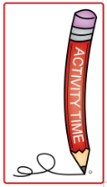
More examples of new laws
Activity
Use sources of information such as newspapers or the internet to find examples of new laws that have been passed through federal and state/territory parliaments.
Identify different points of view of groups in the community about the new law.
Clarify reasons for the points of view that others have taken.
Explain where the idea for a new law came from.

